Slide 1
Collaborative filtering
1 March 2016

Slide 2
Machine Learning Library (MLlib)
Common learning algorithms
Classification,
Regression
Clustering
Collaborative filtering
Dimensionality reduction

Slide 3
ALS (Alternating Least Squares) Recommender Algorithm
Use Case:
Create recommendations based on implicit feedback
Examples of implicit feedback:
User A buys product X & Y
User X listens to songs 1, 2 & 3
Algorithm must scale:
Handle large models
Create recommendations near real time
(*) Implicit: -No explicit feedback/rating needs to be given about the products or songs
-Properties of the user (age, etc) or products are not taken into account

Slide 4
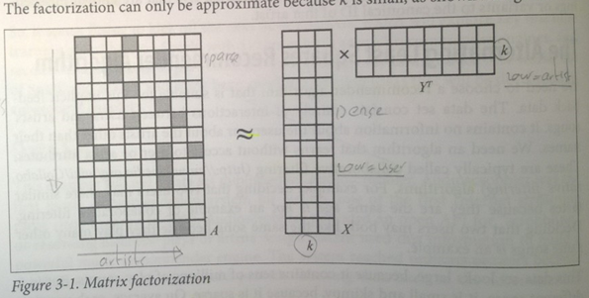
Internal algorithm: Matrix Factorization
A: The (sparse) User-Product matrix
X: The (dense) user matrix, containing users
and some latent features (e.g. taste or genre)
Y: The (dense) product matrix, containing users
and some latent features (e.g. taste or genre)
Initialize Y with random values
X can be calculated
Recalculate Y,
Recalculate X
Etc,
X and Y do eventually converge
Example: http://www.mathwarehouse.com/algebra/matrix/multiply-matrix.php

Slide 5
MLlib - Data Types
Underlying data types for the ML algorithms
Local vector
Labeled point
Local matrix
Distributed matrix
Case class Rating(user: Int, product: Int, rating: Double)

Slide 6
Exercise
1 March 2016

Slide 7
Exercise
Get sources from: https://github.com/erik121212/AlternatingLeastSquares
Look at the sample data
Lauch Spark:
osboxes@osboxes:/$ dse spark
Run Sample code from the repo and answer the questions in this ppt

Slide 8
Sample Data
Look at the data in the file “test.data” and note that:
User 2 and user 3 have the same products but opposite rating than user 1
Only users 1 & 4 have product 6 but with opposite ratings
Notes:
http://spark.apache.org/docs/latest/mllib-clustering.html

Slide 9
Parameters for the train function
val model = ALS.train(ratings, rank, numIterations, 0.01)
Input for train function:
Collection of Rating(s) - RDD of (userID, productID, rating) pairs
rank – size of feature vector
numIterations - number of iterations of ALS (recommended: 10-20)
lambda - regularization factor to avoid overfitting (recommended: 0.01)
Rank, numIterations and lambda are socalled hyperparameters
numIterations is parameters to constrain resources

Slide 10
Testing the model (use the predict function)
What are the predictions of the following ratings?
-User 2 and product 5
-User 3 and product 5
Explain the difference
-User 2 and product 6
-User 3 and product 6
Explain the difference
Use: e.g. model.predict(2,5)
Notes:
http://spark.apache.org/docs/latest/mllib-clustering.html

Slide 11
Latent features
Run the following code and explain how many items you see in the array and what they mean.
model.userFeatures.take(1)
model.productFeatures.take(1)

Slide 12
Export to pmml
`Try exporting the model to pmml

